Slide 1
Azure bound ... a tale of discovery
Matt McLane
DevOps Engineer Criteo Inc.
Notes:
This month, Matt McLane from Criteo will give everyone a glimpse into Criteo's journey from AWS to Azure including their frustrations, the wins, and the tools they relied on to get them there. Additionally, Matt will delve into their in-house developed solutions for utilizing Azure to its fullest, and expand on how they continue to build new services within the Azure ecosystem.

Slide 2

Matt McLane
DevOps Engineer at Criteo
on the cbs-devops team
Notes:
I am a DevOps Engineer on the cbs-devops team here at Criteo.
I have over 20 years of experience in IT.
I enjoy long walks through the woods and automating all the things.
Question:
How many people work in Azure on a regular basis?

Slide 3
A story in three parts
Chapter 1: How we got were we are
Chapter 2: What we built along the way
Chapter 3: Moral of the story
Notes:
Thought I would share our story.
We have been working on a lot of new and interesting things
Others might benefit from what we have learned.
Tell the story in three parts

Slide 4
Not so long ago…

Slide 5
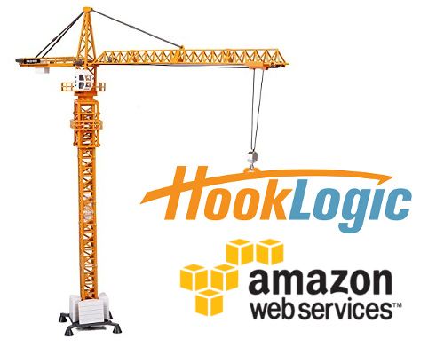
Hooklogic was built on AWS
Notes:
In the spring of 2016 I joined hooklogic, an Advertising technology company
Hooklogic built an advertising exchange to allow advertisers to reach in-market shoppers, drive traffic to products, and attribute resulting sales.
Hooklogic was build on AWS
Heavy S3, lambda, etc.
our team, the devops team was responsible for the AWS infra and deployment pipeline
Asked to build a new version of the pipeline
Cloudformation based
VPCs
Better security
etc.

Slide 6

Criteo acquires hooklogic!
Notes:
Purchased by Criteo - October 2016
Renamed CBS or Criteo Brand Solutions
Bare metal infra
Very large clusters that would cost more to run in the cloud
Ability to have their servers physically closer to servers were their ads are shown.
Migrate from AWS to bare metal servers in Criteo data centers.
Reduce costs by eliminating redundant systems.
Amazon is a competitor, demands of Walmart.

Slide 7
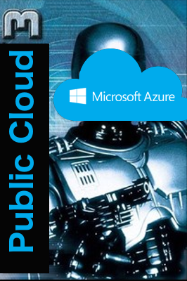
Enter Azure
Notes:
We believe the public cloud has a place in Criteo.
Embraced Azure
Criteo already uses Azure in conjunction with Office 365.
Existing enterprise agreement.
Existing user accounts that are managed by someone else
Built automated pipeline utilizing existing Criteo services.
Started building out offerings.
Took the lessons from before and built a new system.
We thought we could make it better than it was. Better, stronger, faster.

Slide 8
What have we built?

Slide 9

The tools

Slide 10
Starts with Terraform Code
Notes:
We use Terraform to describe our

Slide 11
Code Review
Notes:
Code review done in Gerrit
Presubmit check validates the change
Rubocop
Terraform format
Terraform validate
Workspaces exist
Gets plans

Slide 12
Example Plan

Slide 13
Notes:
Human review’s and gives a +2 if they approve.
Merged

Slide 14
Deployment Pipeline
Notes:
After merge, a deployment pipeline is created in Jenkins
Automatically applies to preprod
Waits for approval to deploy to prod
Deploys to prod
Run inspec on environment after each deployment.

Slide 15
Notes:
Validates that our core cloud infra like vnets, subnets, etc. are unchanged.

Slide 16
The tools
Notes:
We have integrated other tools too
Notifications to to slack
Alerts go to OpsGenie
etc

Slide 17
Future Enhancements
Improving our Inspec implementation
More TF modules
Delegating to other teams
Docker…
TF validation
Prometheus for alerts
Project Atlantis
Notes:
Improving our inspec implementation
Implemented using azure_generic_resource
Two weeks later they deprecated it
We have been contributing to the project to add the resources we need
Wrote the book
More TF modules
We use some but we want to use more
Delegating to other teams
They consume our modules and the pipeline deploys their stuff to prod
Starting with Storage Accounts
Docker
Containerize the runtime environment in which terraform runs.
Waiting on our Jenkins servers to be updated to support docker
TF validation
A mechanism to validate that our TF code is going to succeed, not just written correctly
Example: The VM sizes are valid or naming conventions are followed
Exists for AWS, but not for Azure
Prometheus for alerts
Improved Alerting
Project Atlantis
We would use this if it supported Gerrit.

Slide 18
The moral of the story a.k.a: The good, the different, and the frustrating
Notes:
Back to Azure
I sat my team down in a room and we discussed our impressions of Azure. We tried to categorize things as good, different, and frustrating. While I don’t have time to go over all of our thoughts in detail, I will try to highlight some of them. Feel free to discuss the others with me, or a team mate afterward.

Slide 19



Good
Different
Frustrating
UI & terminology
Subscriptions
Azure exposes VM layer more
Network devices is separate from VM.
More to clean up but more flexible
Network Security Groups
Azure Automation, Functions, Web Apps, etc.
Notes:
I’ll start with different, then go to frustrating, finish with good. Mom always says Its best to end on a good note.
We classified something as different when it wasn’t better or worse, just different
UI & Terminology – Have to get use it it
We all agree that you can get a bit lost in the UI at times.
We like that we can see all regions at once
Subscriptions – Sorta like an AWS account, but it isn’t.
We aren’t sure how we feel about these.
In the past we have used separate AWS accounts to act as a security boundary. Now we are using subscriptions.
Fits into that unified UI experience.
Azure exposes more of the VM layer.
Less of a black box
Not sure if that is a good thing.
Network devices are separate from the VM.
More to clean up
More flexible
Network Security Groups
More like a firewall then an AWS NSG
Two layers of NSGs to manage
So.. Maybe better security, but also more to manage
Azure being serverless first gives more options for serverless computing.
Azure Automate
Azure Fuctions
Axure Web Apps
Etc.
Still figuring out when to use what where.

Slide 20
Good
Different
Frustrating
UI & terminology
Subscriptions
Azure exposes VM layer more
Network devices is separate from VM.
More to clean up but more flexible
Network Security Groups
Azure Automation, Functions, Web Apps, etc.
Figuring out VM Sizes
ICMP Support
Number of secrets
Users don’t have an API key
3rd party tool support
Monolithic API
Alerts are not all we want them to be
Azure Support
Bleeding Edge all the time!
Notes:
What do we dislike:
Figuring out VM Sizes
Not as straight forward and harder to find in the documentation
ICMP Support
Lacking
Number of secrets
Users don’t have an API key
3rd party tool support
Not on par with what is available for AWS
Tools missing or less
Lag behind in new features
Monolithic API
Alerts are not all we want them to be
Azure Support
Beyond level one is slow and sometimes unhelpful
Bleeding Edge all the time!

Slide 21
Good
Different
Frustrating
Bleeding Edge all the time!
Resource Groups
Networking
Locations
Azure CLI
shell.azure.com
Resize an VM on the fly
Azure Support
Storage Accounts
Bundle things
SAS Tokens
Management Locks
UI & terminology
Subscriptions
Azure exposes VM layer more
Network devices is separate from VM.
More to clean up but more flexible
Network Security Groups
Azure Automation, Functions, Web Apps, etc.
Figuring out VM Sizes
ICMP Support
Number of secrets
Users don’t have an API key
3rd party tool support
Monolithic API
Alerts are not all we want them to be
Azure Support
Bleeding Edge all the time!
Notes:
What do we like:
Bleeding Edge all the time!
We have access to all the public previews we want
They are actively making improvements at a rapid pace
Shared Image Gallery
Resource Groups
We like how everything is grouped together and can be deleted all in once shot
Networking
Its magic
Hub and Spoke Networking
Sharing ExpressRoute Connection
Using the Azure Backbone for Inter-Office connections
Locations
16 AWS Regions with 42 Availability Zones
54 Azure Regions world wide
Azure CLI
Extensable
Aliases
Shell.azure.com
Resize a VM on the fly
Without rebooting!
Use case support is high
Azure support
First level support has been great!
Storage Accounts
Bundle all the things
SAS tokens
Management Locks

Slide 22
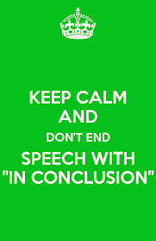
Final thoughts
You will love working in Azure if you like working on the bleeding edge!
Azure has a lot of service offerings to cover any need
Definitely worth considering

